Slide 1
Secure Data Hiding in Image Using Steganography
Presented By :- Suraj Mohapatra
Student Name :- Suraj Mohapatra
College Name :- Gandhi Institute of Technological Advancement (GITA)
Department :- MCA

Slide 2
OUTLINE
Problem Statement
Technology used
Wow factor
End users
Result
Conclusion
Git-hub Link
Future scope

Slide 3
Problem Statement
This project aims to develop an advanced steganography tool that securely hides encrypted messages within image files, ensuring confidential communication for Marcos Commando operations.

Slide 4
Technology used
Python 🐍
OpenCV (cv2) 🖼️
NumPy 🔢
Cryptography (fernet) 🔒

Slide 5
Wow factors
⚡ Fast and efficient encoding/decoding using NumPy operations.
🔐 AES encryption to ensure message confidentiality.
🖼️ Automatic generation of unique encrypted image files to prevent overwriting.

Slide 6
End users
🪖 Marcos Commando Units
🛡️ Defense and Intelligence Agencies

Slide 7
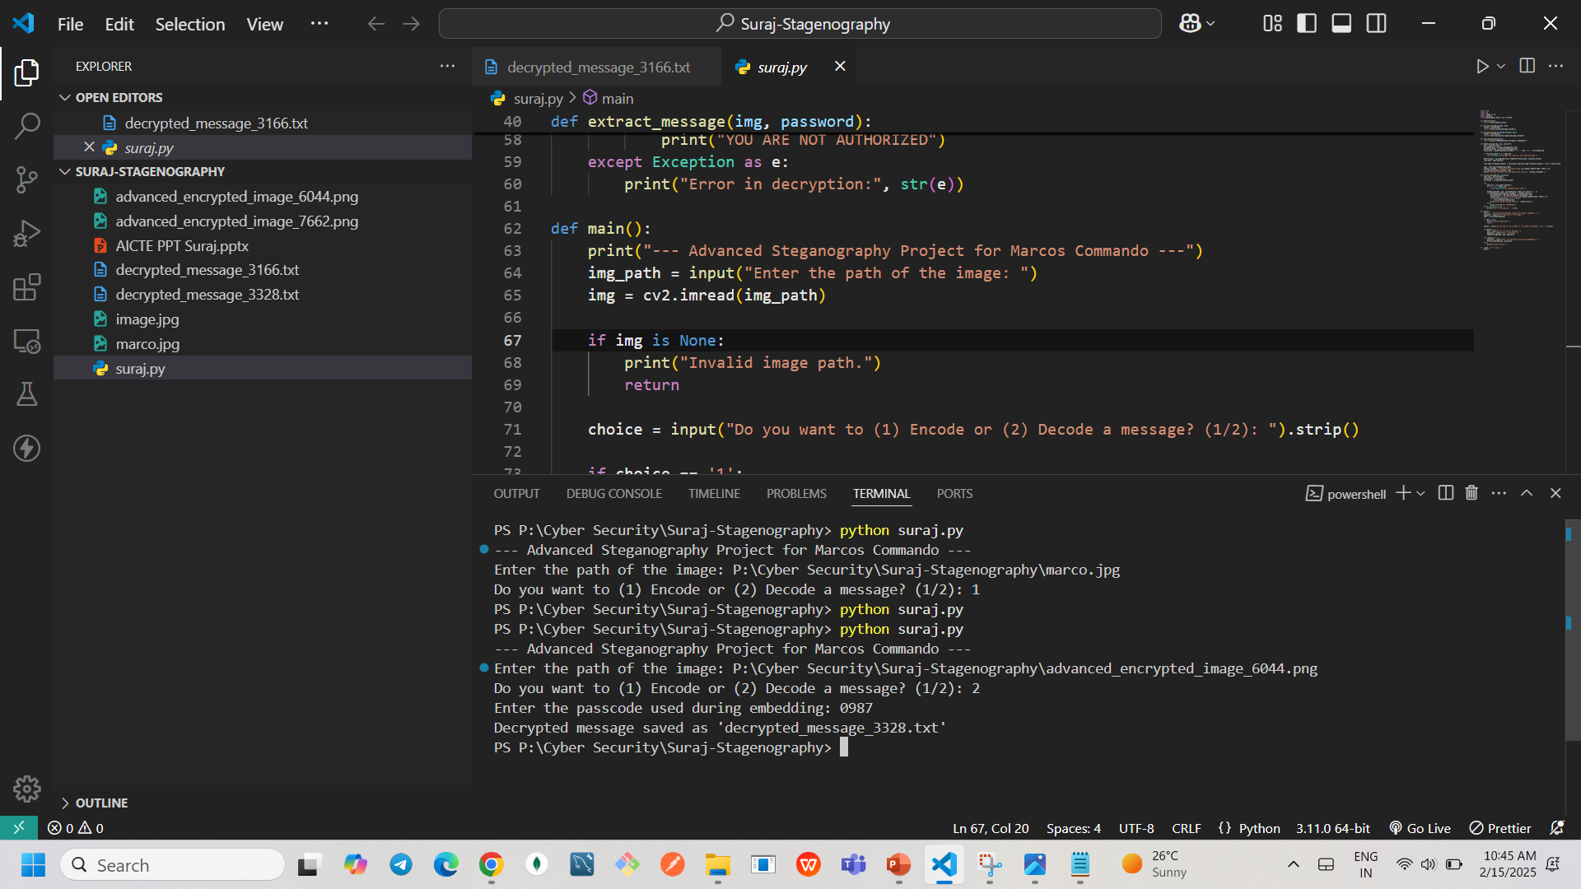
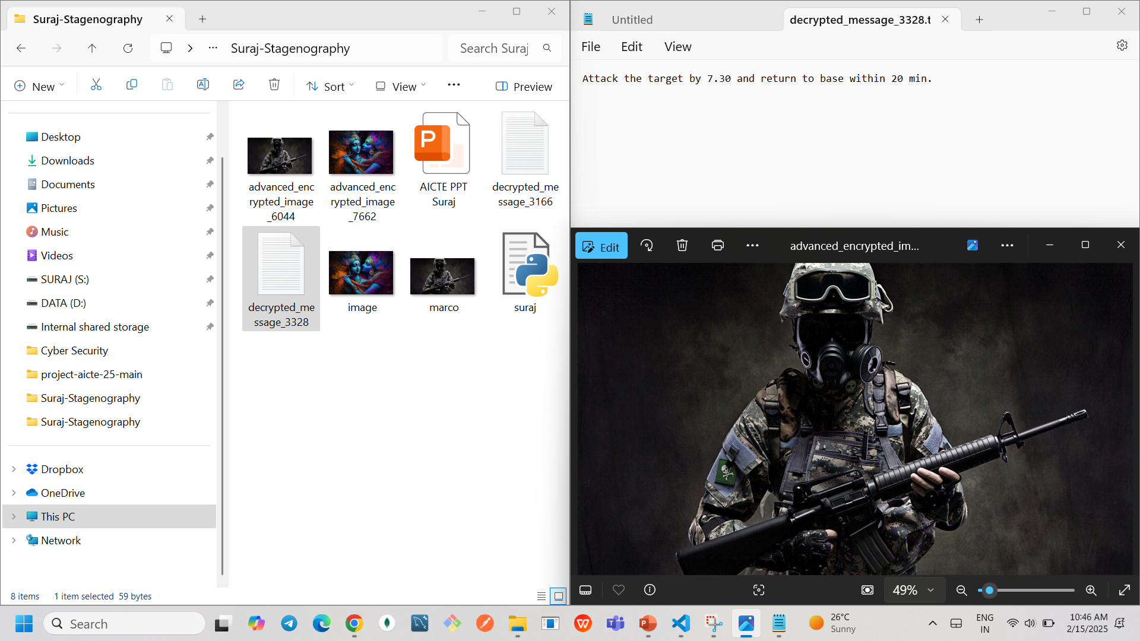
Results
✅ Embedded secret messages in images.
✅ Successful decryption of hidden messages.
✅ Automatic saving of encrypted and decrypted files.

Slide 8
Conclusion
The project provides a reliable and efficient steganography tool for Marcos Commando operations, ensuring secure message transmission using advanced encryption and image processing.

Slide 9
GitHub Link
Make sure that there should be readme file

Slide 10
Future scope(optional)
📹 Extending support for video and audio files.
🔧 Enhancing encryption with customizable algorithms.
🖥️ Developing a user-friendly GUI for non-technical users.

Slide 11
THANK YOU

